Slide 1
Predictive Modeling- Boston House
Introduction-
In this project we will develop and evaluate the performance and the predictive power of a model trained and tested on data collected from Boston dataset.
Once we trained our model and tested we can use our model to predict user input values.
A model like this would be very useful for real-Estate industry people who can make use of information provided on daily basis.

Slide 2
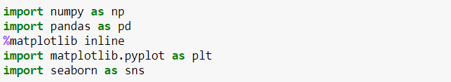
Importing the basic Packages
To perform the model we need a basic python packages. Like
Numpy – For numerical calculation
Pandas – for Data Manipulation
Matplotlib – To perform visual graphs
Seaborn – It again need to perform visual

Slide 3
Data Manipulation
First step before building our model is to understand the data. What are the features, meaning of features and the significance of contribution of each feature to understand how the our target variable behaves.
First thing first, we need to load the data in our notebook and use some command to have look of data also we can look the 5 point summary which can give us details about descriptive statistics of our data.

Slide 4
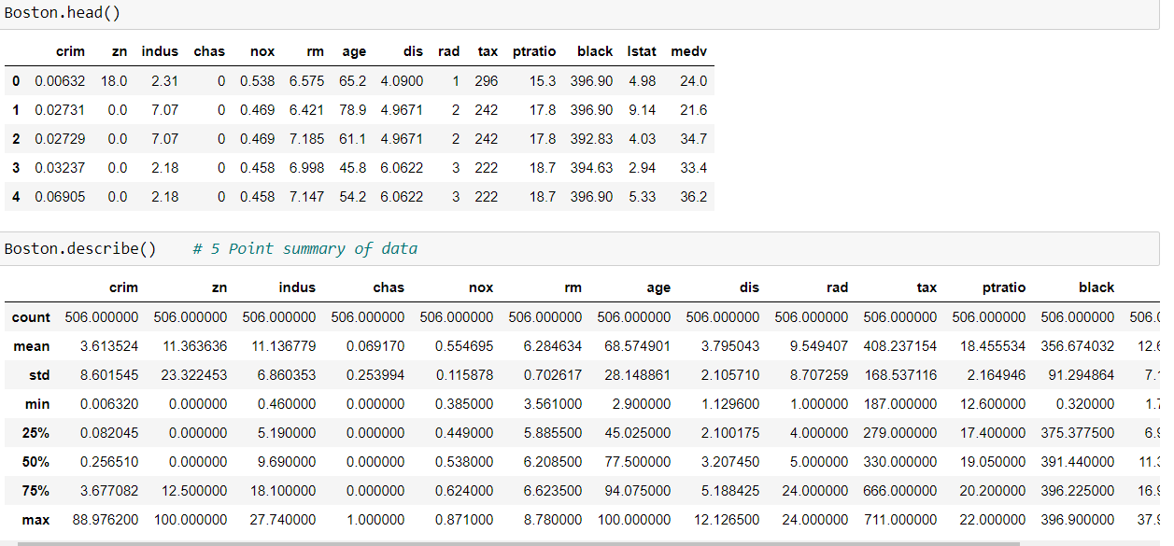
Review and five Points summary

Slide 5
Understanding the Features
From the given source first understand the meaning of each feature.
However the target variable is given which is medv which is nothing but the prices of houses.
Lets have a look on the features and meaning of each feature.
Crim - per capita crime rate by town.
Zn - proportion of residential land zoned for lots over 25,000 sq.ft.
Indus - proportion of non-retail business acres per town.
Chas - Charles River dummy variable (= 1 if tract bounds river; 0 otherwise).

Slide 6
Nox - nitrogen oxides concentration (parts per 10 million).
Rm - average number of rooms per dwelling.
Age - proportion of owner-occupied units built prior to 1940.
Dis - weighted mean of distances to five Boston employment centres.
Rad - index of accessibility to radial highways.
Tax - full-value property-tax rate per \$10,000.
Ptratio - pupil-teacher ratio by town.
Lstat - lower status of the population (percent).
Medv - median value of owner-occupied homes in \$1000s.

Slide 7
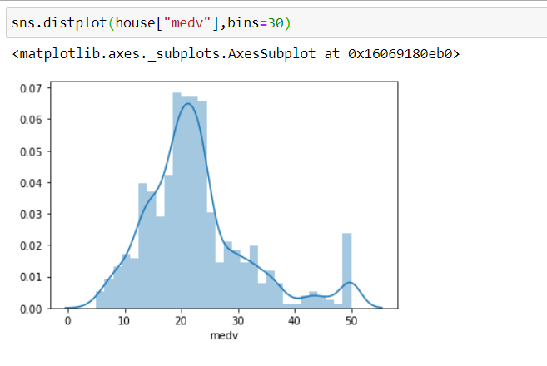
Understanding the Target and features
First lets check how the data is distributed.
From below observation, we can see that, medv values/ prices are normally distributed with few outliers. It is following normal distribution curve.

Slide 8
Understanding the relationship of feature with Target variable
Before building our model lets understand which feature is highly correlated with the target variable so that we can build our model on that basis.
Best way to understand correlation between feature is create heat map
From below heat map we can see the correlation between feature with respect to prices.
We can analyze that , RM and LSTAT are two feature are highly correlated with prices.

Slide 9
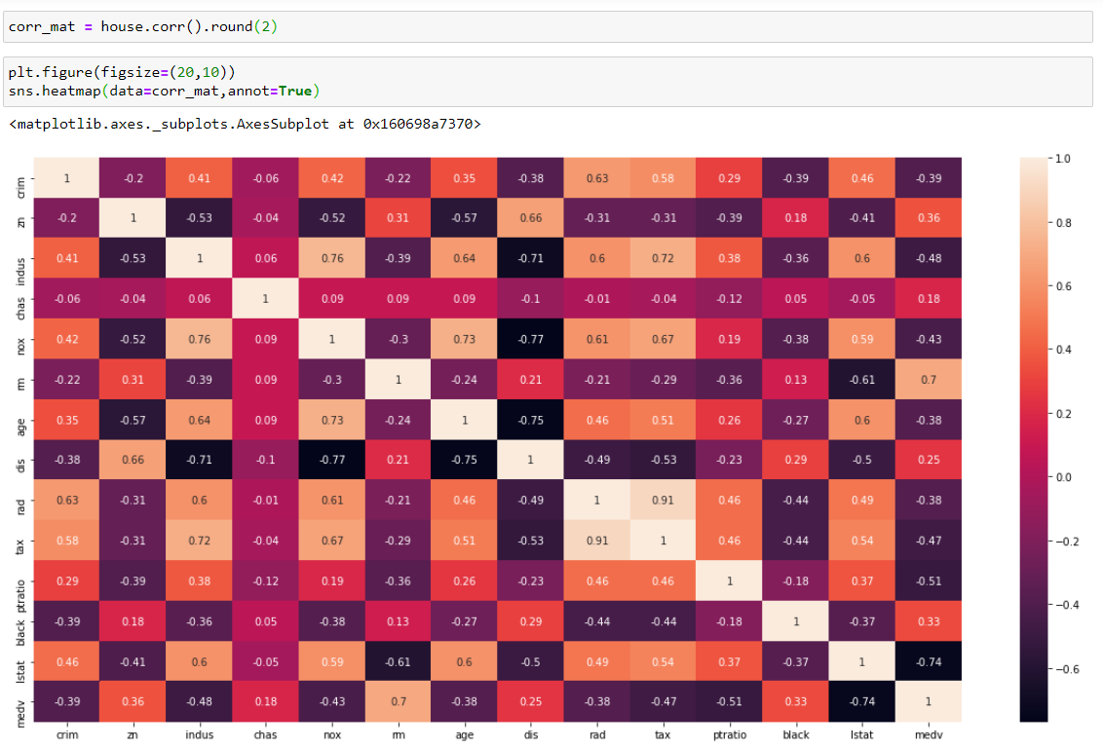

Slide 10
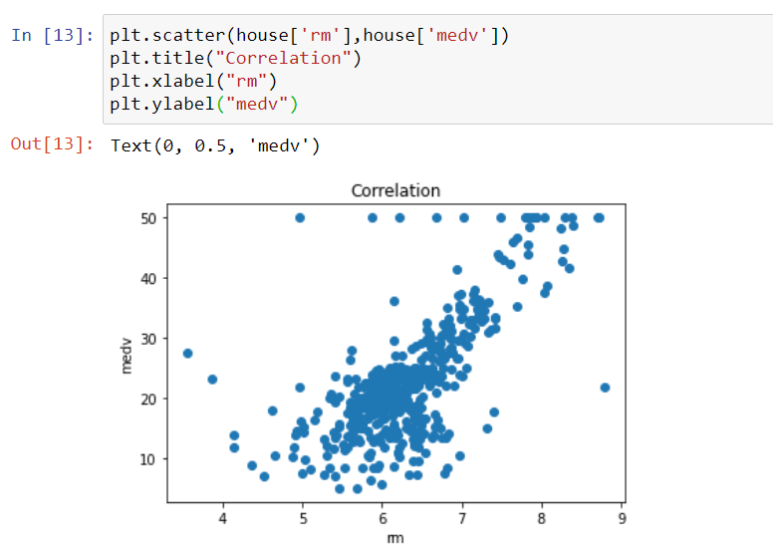
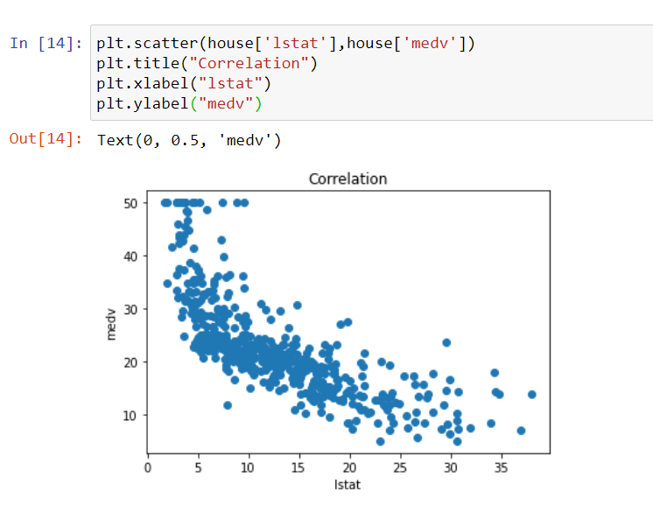
Let’s further understand the relationship in details with scatter plot
In bellow chart we can see the linear relationship of RM and LSTAT with prices.

Slide 11
Findings
For a higher RM, one would expect to observe a higher MEDV.
This is because more rooms would imply more space, thereby costing more, taking all other factors constant.
For a higher LSTAT, one would expect to observe a lower MEDV.
The social milieux in an area dominated by "lower class" citizens may not be conducive for young children. It may also be relatively unsafe compared to an area dominated by "upper class" citizens. Hence an area with more "lower class" citizens would lower demand, hence lower prices.

Slide 12
Converting our data into training and test dataset.
506 rows which is the original dataset
If 507th observation comes in you want to check how well your model is working before predicting its result? But when we put our model into production we want to cross check on some part of our data which is known as test data
X-- features y --- target
X_train --- features of training data
y_train -- target of training data
X_test --- features of test data
y_train --- target of test data

Slide 13
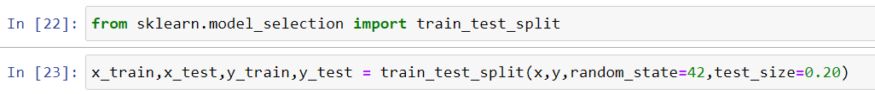
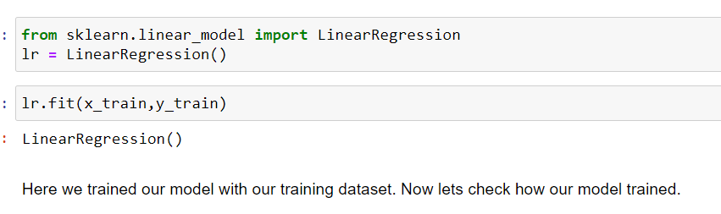
Building our model on training dataset
Let’s split the data using sklearn package by importing the train_test_split
Splitting the dataset into 80% in training and 20% in test
Lets build model with linear regression, by importing linear regression from the sklearn.linear_model

Slide 14
Calculating the Error and check how the model is working
Goodness of fit:
Sum of Squares error – Difference between actual values and predicted values.
Sum of squares due to regression – Difference between predicted and the mean of dependent variable.
Sum of squares total – Difference between the actual dependent and the mean.
From our predicted model and our test data i.e actual data we can find the mean squared error or square root of mean squared error which can give the details about our predictive power of model
Higher the error that model is not well trained.

Slide 15
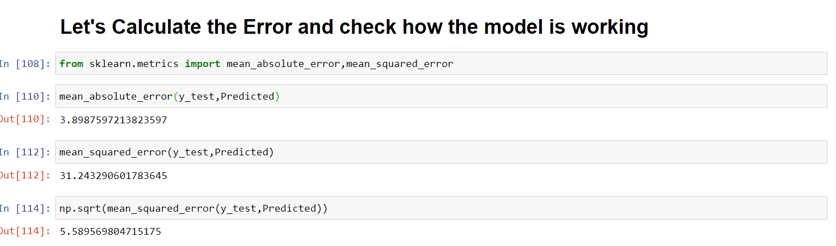
Error calculation of our Model

Slide 16
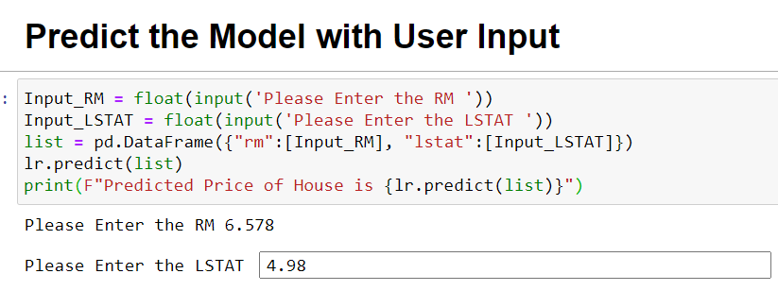
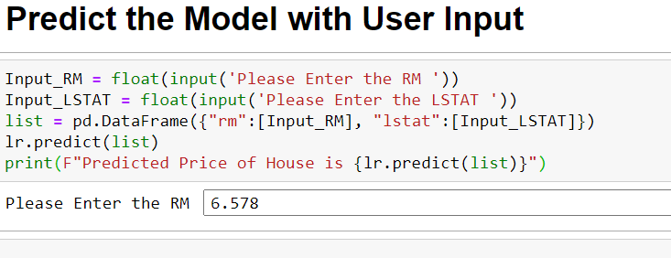
Let’s Predict Our Model with User Input
We can now use or model to predict the price of house by taking RM and LSTAT input from user. In below screenshot we can run the code and put input and predict the price.

Slide 17
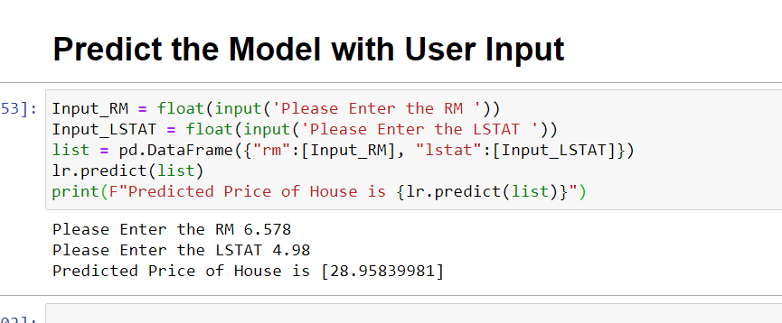
Final Result of User Input
Predicted Value by Model

Slide 18
Thank You.

